Slide 1


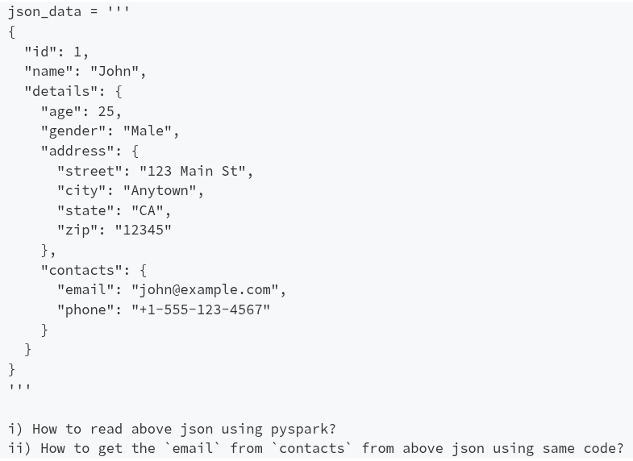

PySpark Interview Question: 29
Question 01
Question 02

